Slide 1
Flagstaff Robotic Survey Telescope (FRoST) Software
Michael Rynders
Dr. David Trilling
Northern Arizona University

Slide 2
Acknowledgments
Dr. David Trilling
Dr. Nadine Barlow
Kathleen Stigmon
Dan Avner
NASA Space Grant
Michael Rynders

Slide 3
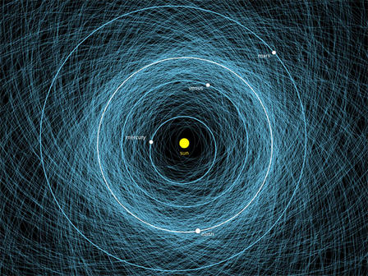
Near Earth Asteroids
Impact risk
Hard to see
Fast
Uncertain orbits
From Paul Chodas, AMNH 02/15/2013
Michael Rynders

Slide 4
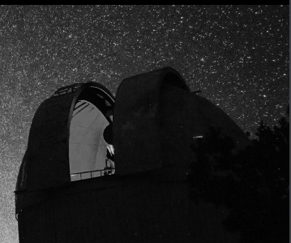
Flagstaff RObotic Survey Telescope (FRoST)
Dan Avner
0.6m Schmidt Telescope
Located at Anderson Mesa
~20th Magnitude
1 deg² Field of View
Rapid observations and follow-ups
Michael Rynders

Slide 5
The Goal - Automatically Observe Objects
List of best targets and their locations to observe hourly
This Code
cneos.jpl.nasa.gov
Sorted
List
NASA
Database
Filter
Calculate time until lost
Calculate needed observations
Rank Priority
Objects
Sorted
list
FRoST
Michael Rynders

Slide 6
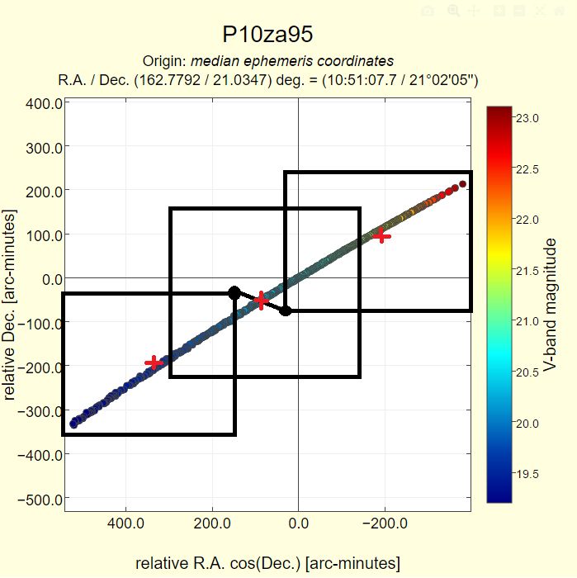
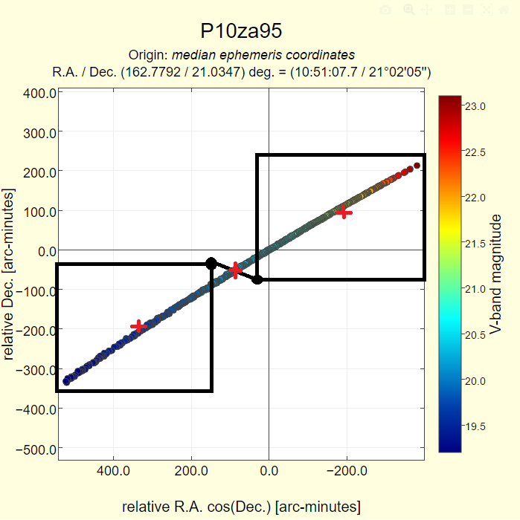
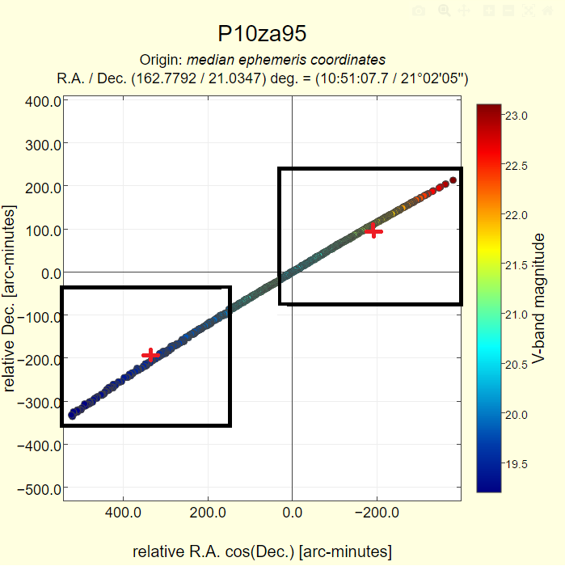
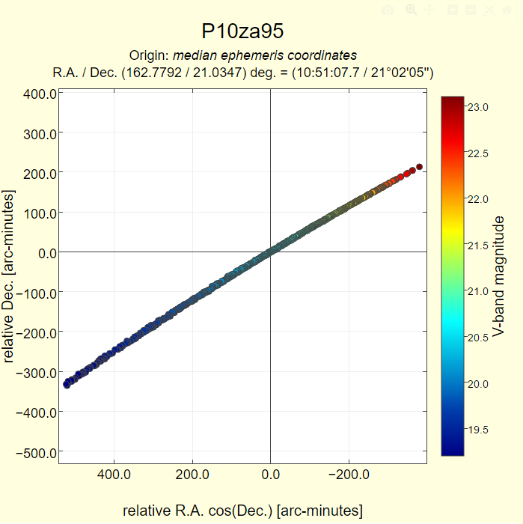
Finding One Asteroid
Michael Rynders

Slide 7
Priority Ranking
Considered Factors
Too many observations
Already observed by FRoST
Too many frames needed
Lots of days left to observe
Impact Chance
Brightness
Size
Uncertainty
Adjustable Algorithm
Michael Rynders

Slide 8
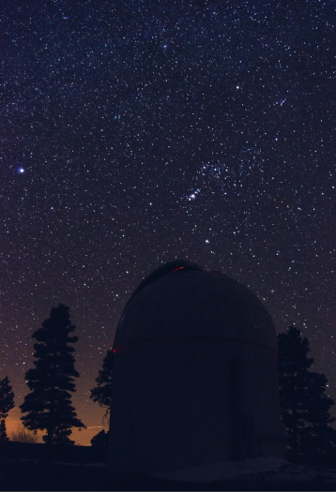
Summary
Improves Efficiency
Better understanding of Asteroids
Adjustable
Pilot Program
Michael Rynders

